Slide 1
An Introduction to Software Engineering

Slide 2
Introduction

Slide 3
To introduce software engineering and to explain its importance
To introduce ethical and professional issues and to explain why they are of concern to software engineers

Slide 4
Software engineering
The economies of ALL developed nations are
dependent on software.
More and more systems are software controlled
Software engineering is concerned with theories, methods and tools for professional software development.
Expenditure on software represents a
significant fraction of GNP in all developed countries.

Slide 5
Software costs
Software costs often dominate computer system costs.
The costs of software on a PC are often greater than the hardware cost.
Software costs more to maintain than it does to develop.
Software engineering is concerned with cost-effective software development.

Slide 6
FAQs about software engineering
What is software?
What is software engineering?
What is the difference between software engineering and computer science?
What is the difference between software engineering and system engineering?
What is a software process?
What is a software process model?

Slide 7
FAQs about software engineering
What are the costs of software engineering?
What are software engineering methods?
What is CASE (Computer-Aided Software Engineering)
What are the attributes of good software?
What are the key challenges facing software engineering?

Slide 8
What is software?
Computer programs and associated documentation such as requirements, design models and user manuals.
Software products may be developed for a particular customer or may be developed for a general market.
Software products may be
  Generic - developed to be sold to a range of different customers e.g. PC software such as Excel or Word.
  Custom - developed for a single customer according to their specification.
New software can be created by developing new programs, configuring generic software systems or reusing existing software.

Slide 9
What is software engineering?
Software engineering is an engineering discipline that is concerned with all aspects of software production.
Software engineers should adopt a systematic and organised approach to their work and use appropriate tools and techniques.
Depending on the problem to be solved, the development constraints and the resources available.

Slide 10
What is the difference between software engineering and computer science?
Computer science is concerned with theory and fundamentals;
software engineering is concerned with the practicalities of developing and delivering useful software.

Slide 11
What is the difference between software engineering and system engineering?
System engineering is concerned with all aspects of computer-based systems development including hardware, software and process engineering.
Software engineering is part of this process concerned with developing the software infrastructure, control, applications and databases in the system.
System engineers are involved in system specification, architectural design, integration and deployment.

Slide 12
What is a software process?
A set of activities whose goal is the development or evolution of software.
Generic activities in all software processes are:
Specification - what the system should do and its development
constraints
  Development - production of the software system
  Validation - checking that the software is what the customer
  wants
  Evolution - changing the software in response to changing
  demands.

Slide 13
Life-Cycle Phases
Requirements
Architecture & design
Construction
Deployment & Maintenance
Integral Activities
Documentation
Measurement & evaluation
Management of objects
Teamwork
Evolution

Slide 14
What is a software process model?
A simplified representation of a software process, presented from a specific perspective.
Examples of process perspectives are
  Workflow perspective - sequence of activities;
  Data-flow perspective - information flow;
  Role/action perspective - who does what.
Generic process models
  Waterfall;
  Iterative development;
  Component-based software engineering.

Slide 15
What are the costs of software engineering?
Roughly 60% of costs are development costs, 40% are testing costs. For custom software, evolution costs often exceed development costs.
Costs vary depending on the type of system being developed and the requirements of system attributes such as performance and system reliability.
Distribution of costs depends on the development model that is used.

Slide 16
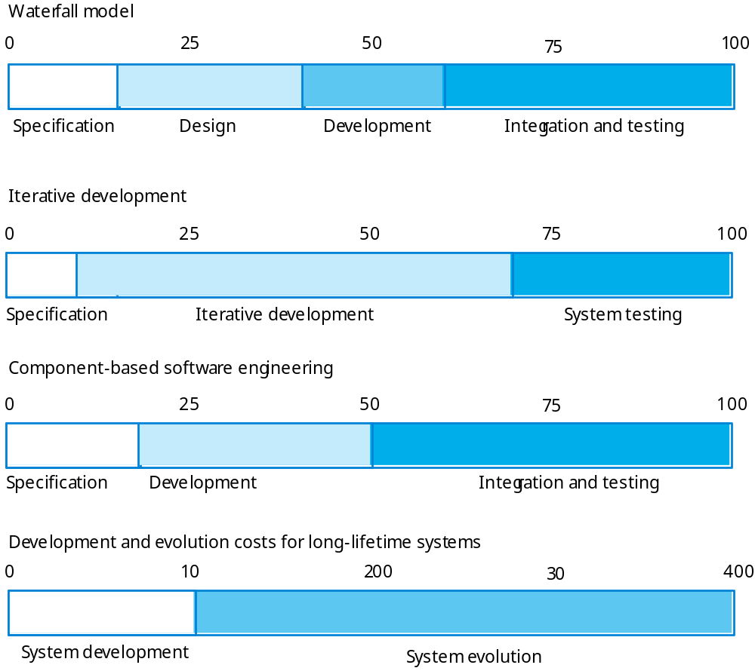
Activity cost distribution

Slide 17
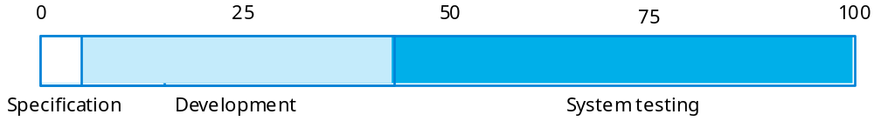
Product development costs

Slide 18
What are software engineering methods?
Structured approaches to software development which include system models, notations, rules, design advice and process guidance.
Model descriptions
  Descriptions of graphical models which should be produced;
Rules
  Constraints applied to system models;
Recommendations
  Advice on good design practice;
Process guidance
  What activities to follow.

Slide 19
What is CASE (Computer-Aided Software Engineering)
Software systems that are intended to provide automated support for software process activities.
CASE systems are often used for method support.
Upper-CASE
  Tools to support the early process activities of requirements and design;
Lower-CASE
  Tools to support later activities such as programming, debugging and testing.

Slide 20
What are the attributes of good software?
The software should deliver the required functionality and performance to the user and should be maintainable, dependable and acceptable.
Maintainability
  Software must evolve to meet changing needs;
Dependability
  Software must be trustworthy;
Efficiency
  Software should not make wasteful use of system resources;
Acceptability
  Software must accepted by the users for which it was designed. This means it must be understandable, usable and compatible with other systems.

Slide 21
What are the key challenges facing software engineering?
Heterogeneity, delivery and trust.
Heterogeneity
  Developing techniques for building software that can cope with heterogeneous platforms and execution environments;
Delivery
  Developing techniques that lead to faster delivery of software;
Trust
  Developing techniques that demonstrate that software can be trusted by its users.

Slide 22
Professional and ethical responsibility
Software engineering involves wider responsibilities than simply the application of technical skills.
Software engineers must behave in an honest and ethically responsible way if they are to be respected as professionals.
Ethical behaviour is more than simply upholding the law.

Slide 23
Issues of professional responsibility
Confidentiality
  Engineers should normally respect the confidentiality of their employers or clients irrespective of whether or not a formal confidentiality agreement has been signed.
Competence
  Engineers should not misrepresent their level of competence. They should not knowingly accept work which is outwith their competence.

Slide 24
Issues of professional responsibility
Intellectual property rights
  Engineers should be aware of local laws governing the use of intellectual property such as patents, copyright, etc. They should be careful to ensure that the intellectual property of employers and clients is protected.
Computer misuse
  Software engineers should not use their technical skills to misuse other people’s computers. Computer misuse ranges from relatively trivial (game playing on an employer’s machine, say) to extremely serious (dissemination of viruses).

Slide 25
ACM/IEEE Code of Ethics
The professional societies in the US have cooperated to produce a code of ethical practice.
Members of these organisations sign up to the code of practice when they join.
The Code contains eight Principles related to the behaviour of and decisions made by professional software engineers, including practitioners, educators, managers, supervisors and policy makers, as well as trainees and students of the profession.

Slide 26
Code of ethics - principles
PUBLIC
  Software engineers shall act consistently with the public interest.
CLIENT AND EMPLOYER
  Software engineers shall act in a manner that is in the best interests of their client and employer consistent with the public interest.
PRODUCT
  Software engineers shall ensure that their products and related modifications meet the highest professional standards possible.

Slide 27
Code of ethics - principles
JUDGMENT
  Software engineers shall maintain integrity and independence in their professional judgment.
MANAGEMENT
  Software engineering managers and leaders shall subscribe to and promote an ethical approach to the management of software development and maintenance.
PROFESSION
  Software engineers shall advance the integrity and reputation of the profession consistent with the public interest.

Slide 28
Code of ethics - principles
COLLEAGUES
  Software engineers shall be fair to and supportive of their colleagues.
SELF
  Software engineers shall participate in lifelong learning regarding the practice of their profession and shall promote an ethical approach to the practice of the profession.

Slide 29
Key points
Software engineering is an engineering discipline that is concerned with all aspects of software production.
Software products consist of developed programs and associated documentation. Essential product attributes are maintainability, dependability, efficiency and usability.
The software process consists of activities that are involved in developing software products. Basic activities are software specification, development, validation and evolution.
Methods are organised ways of producing software. They include suggestions for the process to be followed, the notations to be used, rules governing the system descriptions which are produced and design guidelines.

Slide 30
Software Processes

Slide 31
Objectives
To introduce software process models
To describe three generic process models and when they may be used
To describe outline process models for requirements engineering, software development, testing and evolution
To introduce CASE technology to support software process activities

Slide 32
The software process
A structured set of activities required to develop a
software system
  Specification;
  Design;
  Validation;
  Evolution.
A software process model is an abstract representation of a process. It presents a description of a process from some particular perspective.

Slide 33
Generic software process models
The waterfall model
  Separate and distinct phases of specification and development.
Evolutionary development
  Specification, development and validation are interleaved.
Component-based software engineering
  The system is assembled from existing components.

Slide 34
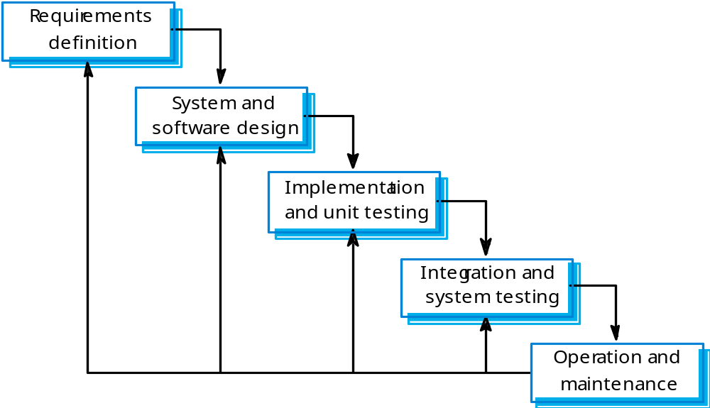
Waterfall model

Slide 35
Waterfall model phases
Requirements analysis and definition
System and software design
Implementation and unit testing
Integration and system testing
Operation and maintenance
The main drawback of the waterfall model is the difficulty of accommodating change after the process is underway. One phase has to be complete before moving onto the next phase.

Slide 36
Waterfall model problems
Inflexible partitioning of the project into distinct stages makes it difficult to respond to changing customer requirements.
Therefore, this model is only appropriate when the requirements are well-understood and changes will be fairly limited during the design process.
Few business systems have stable requirements.
The waterfall model is mostly used for large systems engineering projects where a system is developed at several sites.

Slide 37
Evolutionary development
Exploratory development
  Objective is to work with customers and to evolve a final system from an initial outline specification.
  Should start with well-understood requirements and add new features as proposed by the customer.
Throw-away prototyping
  Objective is to understand the system requirements.
  Should start with poorly understood requirements to clarify what is really needed.

Slide 38
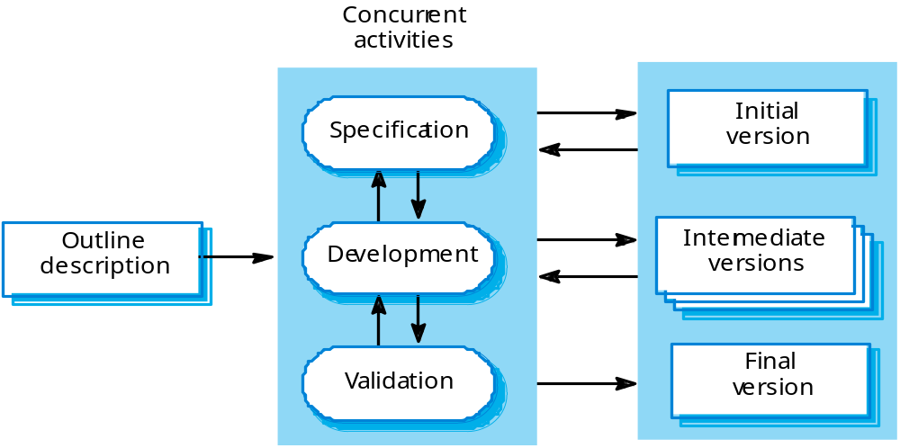
Evolutionary development

Slide 39
Evolutionary development
Problems
  Lack of process visibility;
  Systems are often poorly structured;
  Special skills (e.g. in languages for rapid prototyping) may be required.
Applicability
  For small or medium-size interactive systems;
  For parts of large systems (e.g. the user interface);
  For short-lifetime systems.

Slide 40
Component-based software engineering
Based on systematic reuse where systems are integrated from existing components or COTS (Commercial-off-the-shelf) systems.
Process stages
  Component analysis;
  Requirements modification;
  System design with reuse;
  Development and integration.
This approach is becoming increasingly used as component standards have emerged.

Slide 41
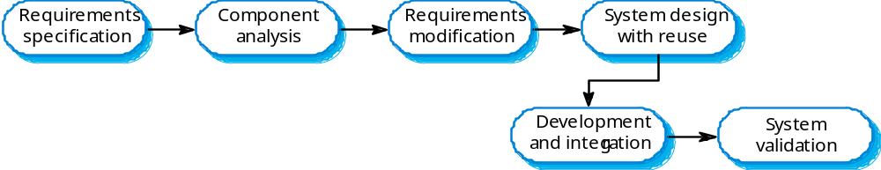
Reuse-oriented development

Slide 42
Process iteration
System requirements ALWAYS evolve in the course of a project.
Therefore process iteration where earlier stages are reworked is always part of the process for large systems.
Iteration can be applied to any of the generic process models.
Two (related) approaches
  Incremental delivery;
  Spiral development.

Slide 43
Incremental delivery
Rather than deliver the system as a single delivery, the development and delivery is broken down into increments with each increment delivering part of the required functionality.
User requirements are prioritised and the highest priority requirements are included in early increments.
Once the development of an increment is started, the requirements are frozen though requirements for later increments can continue to evolve.

Slide 44
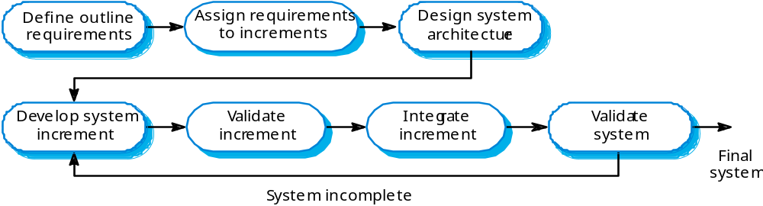
Incremental development

Slide 45
Incremental development advantages
Customer value can be delivered with each increment so system functionality is available earlier.
Early increments act as a prototype to help elicit requirements for later increments.
Lower risk of overall project failure.
The highest priority system services tend to receive the most testing.

Slide 46
Spiral development
Process is represented as a spiral rather than as a sequence of activities with backtracking.
Each loop in the spiral represents a phase in the process.
No fixed phases such as specification or design - loops in the spiral are chosen depending on what is required.
Risks are explicitly assessed and resolved throughout the process.

Slide 47
Spiral model sectors
Objective setting
  Specific objectives for the phase are identified.
Risk assessment and reduction
  Risks are assessed and activities put in place to reduce the key risks.
Development and validation
  A development model for the system is chosen which can be any of the generic models.
Planning
  The project is reviewed and the next phase of the spiral is planned.

Slide 48
Spiral model of the software process
Deter
mine objecti
v
es,
Ev
alua
te alternatives
alterna
ti
v
es and
identify
, r
esolv
e risks
constr
aints
Risk
anal
ysis
Risk
anal
ysis
Risk
Oper
a-
anal
ysis
Pr
ototype 3
tional
Pr
ototype 2
pr
oto
ype
Risk
Pr
oto-
R
EVI
EW
anal
ysis
type 1
R
equir
ements plan
Sim
ula
tions
, models
, benchmar
ks
Life-cy
cle plan
Concept of
Oper
a
tion
S/W
r
equir
ements
Pr
oduct
Detailed
design
design
De
v
elopment
R
equir
ement
plan
v
alida
tion
Code
Integ
r
a
tion
Design
Unit test
and test plan
V&V
Integ
r
a
tion
Plan ne
xt phase
Acceptance
test
Service
test
De
v
elop
, v
erify
ne
xt-le
v
el pr
oduct

Slide 49
Process activities
Software specification
Software design and implementation
Software validation
Software evolution

Slide 50
Software specification
The process of establishing what services are required and the constraints on the system’s operation and development.
Requirements engineering process
  Feasibility study;
  Requirements elicitation and analysis;
  Requirements specification;
  Requirements validation.

Slide 51
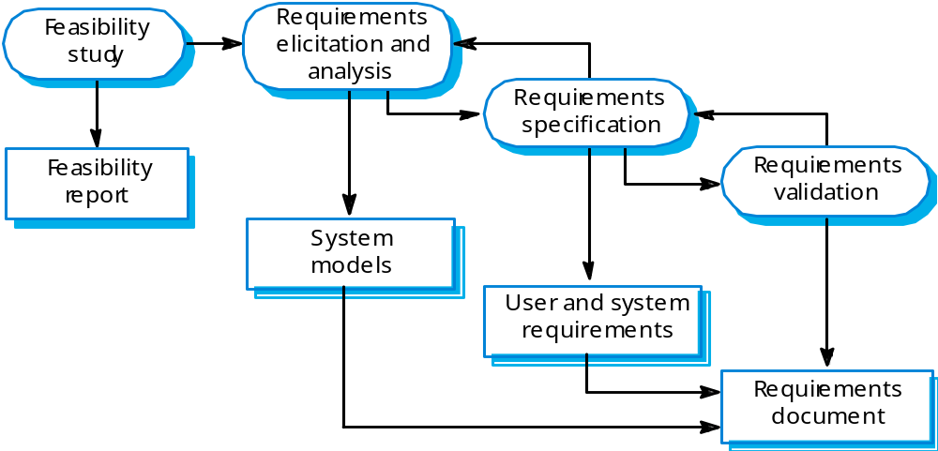
The requirements engineering process

Slide 52
Software design and implementation
The process of converting the system specification into an executable system.
Software design
  Design a software structure that realises the specification;
Implementation
  Translate this structure into an executable program;
The activities of design and implementation are closely related and may be inter-leaved.

Slide 53
Design process activities
Architectural design
Abstract specification
Interface design
Component design
Data structure design
Algorithm design

Slide 54
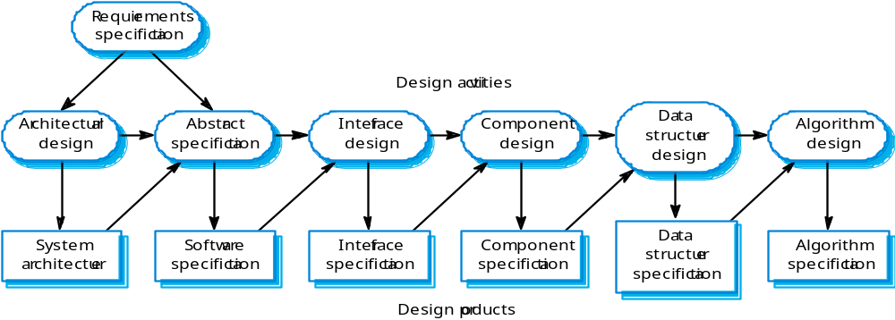
The software design process

Slide 55
Structured methods
Systematic approaches to developing a software design.
The design is usually documented as a set of graphical models.
Possible models
  Object model;
  Sequence model;
  State transition model;
  Structural model;
  Data-flow model.

Slide 56
Programming and debugging
Translating a design into a program and removing errors from that program.
Programming is a personal activity - there is no generic programming process.
Programmers carry out some program testing to discover faults in the program and remove these faults in the debugging process.

Slide 57
The debugging process

Slide 58
Software validation
Verification and validation (V & V) is intended to show that a system conforms to its specification and meets the requirements of the system customer.
Involves checking and review processes and system testing.
System testing involves executing the system with test cases
That are derived from the specification of the real data to be processed by the system.

Slide 59
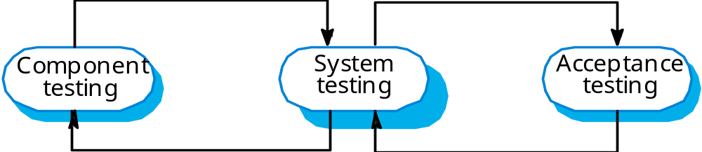
The testing process

Slide 60
Testing stages
Component or unit testing
  Individual components are tested independently;
  Components may be functions or objects or coherent groupings of these entities.
System testing
  Testing of the system as a whole. Testing of emergent properties is particularly important.
Acceptance testing (alpha testing)
  Testing with customer data to check that the system meets the customer’s needs.

Slide 61
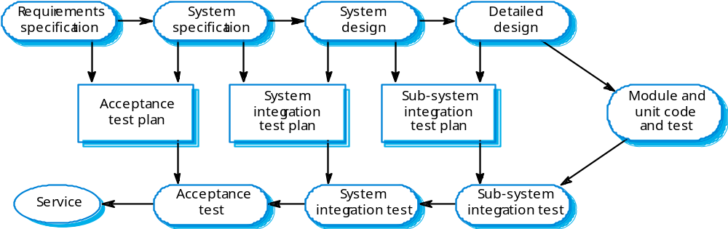
Testing phases

Slide 62
Software evolution
Software is inherently flexible and can change.
As requirements change through changing business circumstances, the software that supports the business must also evolve and change.
Although there has been a distinction between development and evolution (maintenance)
This is increasingly irrelevant as fewer and fewer systems are completely new.

Slide 63
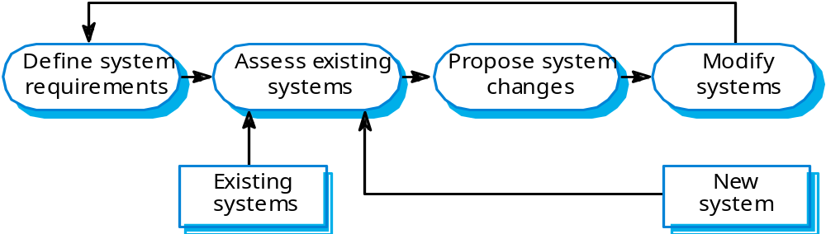
System evolution

Slide 64
Computer-aided software engineering
Computer-aided software engineering (CASE) is software to support software development and evolution processes.
Activity automation
  Graphical editors for system model development;
  Data dictionary to manage design entities;
  Graphical UI builder for user interface construction;
  Debuggers to support program fault finding;
  Automated translators to generate new versions of a program.

Slide 65
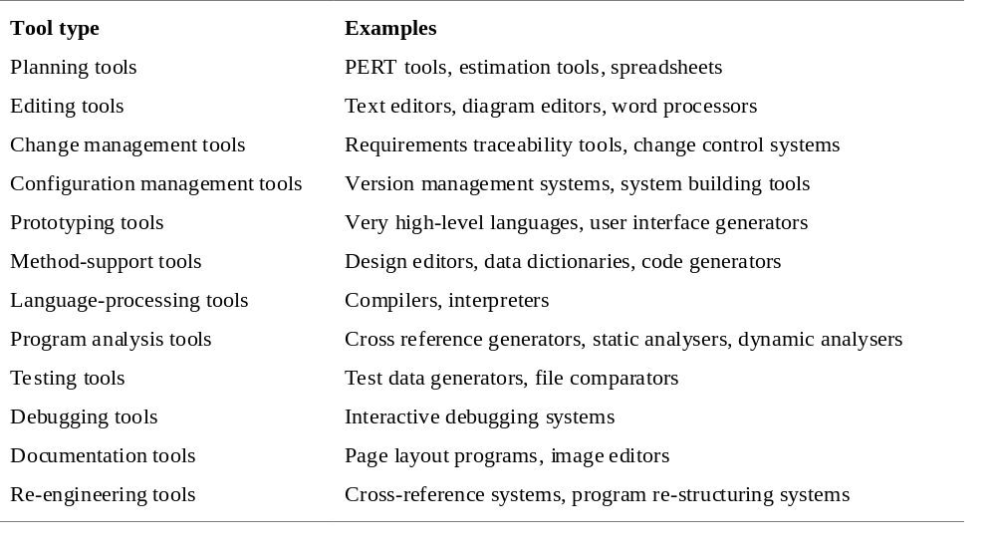
Functional tool classification

Slide 66
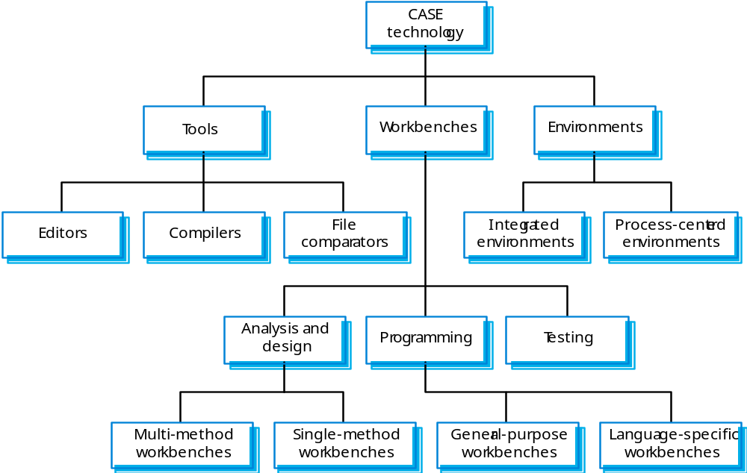
Tools, workbenches, environments

Slide 67
Key points
Software processes are the activities involved in producing and evolving a software system.
Software process models are abstract representations of these processes.
General activities are specification, design and implementation, validation and evolution.
Generic process models describe the organisation of software processes. Examples include the waterfall model, evolutionary development and component-based software engineering.
Iterative process models describe the software process as a cycle of activities.

Slide 68
Key points
Requirements engineering is the process of developing a software specification.
Design and implementation processes transform the specification to an executable program.
Validation involves checking that the system meets to its specification and user needs.
Evolution is concerned with modifying the system after it is in use.
The Rational Unified Process is a generic process model that separates activities from phases.
CASE technology supports software process activities.

